Slide 1
Houston Tech Fest DevOps in a Cloud World
Shawn Weisfeld
Cloud Solution Architect
Microsoft

Slide 2









Thanks to all our sponsors without whom there would be no Techfest

Slide 3
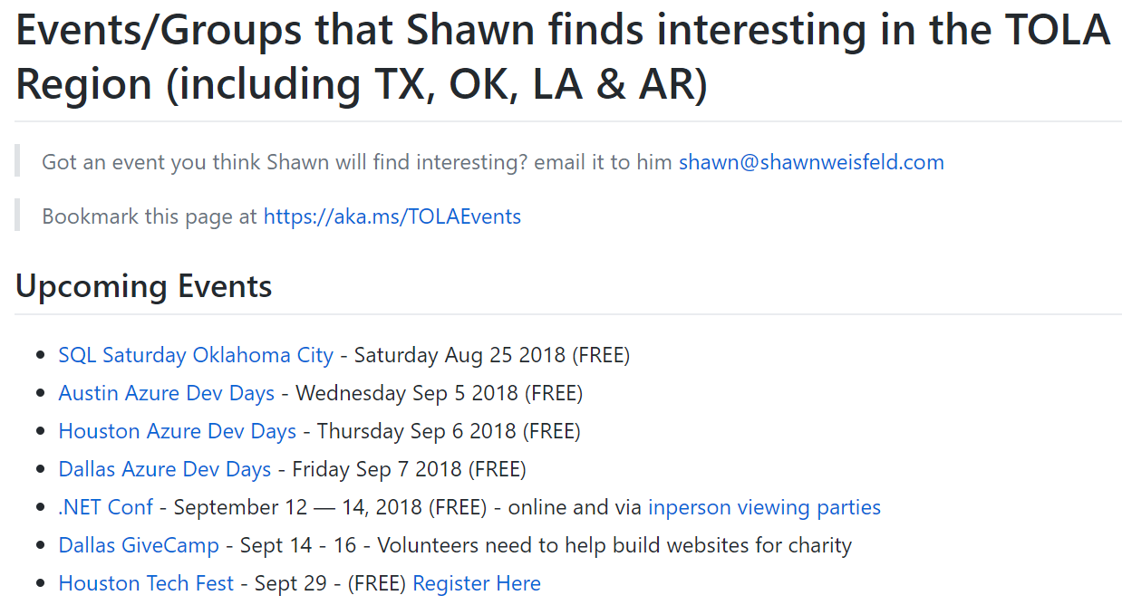

Regional Events
https://aka.ms/TOLAEvents

Slide 4


Watch User Group presentations for FREE online! We now have over 850 presentations online
Miss a User Group meeting?
Forget something that you learned?
Want to see content from a User Group not in your area?
Want to share with a buddy?
Presentations from the thought leaders on the topics you care about including:
Agile
Azure
C#
Entity Framework
HTML5
MVC
SQL
jQuery
and Much More!
We know you cannot make it to every session,
that is why we post them online for you!
New Content added all the time!
For new content announcements
@UserGroupTV
http://www.UserGroup.tv

Slide 5

About Me
Shawn Weisfeld
Cloud Solution Architect
Microsoft – One Commercial Partner Technical Team
sweisfel@microsoft.com
Austin, TX

Slide 6

About you
Let me know a bit about you
https://aka.ms/2018HTFSurvey
or scan this

Slide 7
DevOps is…
Continuous Delivery
Operations, Learning & Feedback
Test & Verification
Agile management
Infrastructure, Policy & Configuration as Code
Developer workflow
Automated build / deploy and release pipelines
Artifact management
DevOps is the union of people, process, and tools to enable continuous delivery of value to our end users.
High performance DevOps companies achieve:*
46x more frequent deployments
440x faster lead time for changes
96x faster mean time to recover (MTTR)
5x lower change failure rate
20% faster time to market
20% increased revenue
*Source: 2017 State of DevOps Report presented by Puppet and DORA
Notes:
DevOps relies on people, process and products
DevOps provides real business value – even if you aren’t embracing DevOps practices, your competition likely is
Continuous Delivery relies on common practice (see graphic)

Slide 8

What is DevOps?
“Development and Operations collaboration”
“Automation”
“Faster and smaller releases”
“A job title”

Slide 9


Slide 10
Practices supporting successful DevOps
Agile management
Development workflow
Artifact management
Automated build / deploy and release pipelines
Infrastructure, Policy & Configuration as Code
Operations, Learning & Feedback
Test & Verification
Agile & Lean Kanban boards Task boards Enterprise alignment Collaboration Reporting Process metrics … | Source control Code reviews Pull Requests Branch management Unit testing Code analysis Quality feedback … | Publish reusable artifacts to private repos Consume reusable artifacts from private repos Proxy public repo sources (e.g., NuGet, Maven, NPM, …) to allow enterprise governance … | Capture VM and network as code Capture VM configuration as code Capture modern cloud resources as code Automate provisioning and configuration … | Automated build and packaging Automated test execution Automated deployment Release management Release gates … | Automated testing Manual testing Exploratory testing Requirements coverage Test reporting … | Dynamic Scale Flexible Infrastructure Monitor services, applications and infrastructure Provide alerting and visualizations based on telemetry Streamline MTTD and MTTR Provide actionable feedback to teams …
Notes:
Notes: Make sure they know to gloss over this…

Slide 11






Azure DevOps… the evolution of Visual Studio Team Services
Azure DevOps
Visual Studio Team Services
Azure Boards
Azure Repos
Azure Artifacts
Azure Pipelines
Azure Test Plans
Plan & Track
Develop
Reusable Artifacts
Continuous Integration & Delivery
Quality & Testing

Slide 12







Introducing Azure DevOps
Azure Boards
Azure Repos
Azure Artifacts
(Other Azure)
Azure Pipelines
Azure Test Plans
(Other Azure)
Agile management
Development workflow
Artifact management
Automated build / deploy and release pipelines
Infrastructure, Policy & Configuration as Code
Operations, Learning & Feedback
Test & Verification
Agile & Lean Kanban boards Task boards Enterprise alignment Collaboration Reporting Process metrics … | Source control Code reviews Pull Requests Branch management Unit testing Code analysis Quality feedback … | Publish reusable artifacts to private repos Consume reusable artifacts from private repos Proxy public repo sources (e.g., NuGet, Maven, NPM, …) to allow enterprise governance … | Capture VM and network as code Capture VM configuration as code Capture modern cloud resources as code Automate provisioning and configuration … | Automated build and packaging Automated test execution Automated deployment Release management Release gates … | Automated testing Manual testing Exploratory testing Requirements coverage Test reporting … | Dynamic Scale Flexible Infrastructure Monitor services, applications and infrastructure Provide alerting and visualizations based on telemetry Streamline MTTD and MTTR Provide actionable feedback to teams …
Notes:
Azure supports all of the services that you need to for efficient and enterprise-grade DevOps practices.
The new Azure DevOps services support a majority of these practices and… [click]
augment the existing Microsoft and Azure technologies to provide a complete end-to-end DevOps solution.

Slide 13

Integrated AND Independent
Azure DevOps is…
…a series of integrated services that provide consistent usage, consolidated administration and superb end-to-end traceability.
…a series of independent services that can be integrated with other third-party and open source DevOps tools, providing an experience tailored to your needs.

Slide 14
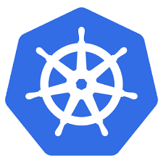
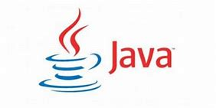
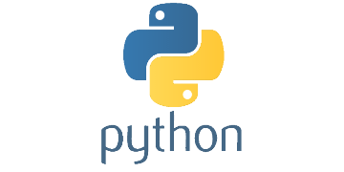

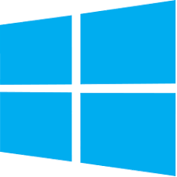
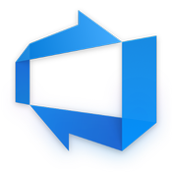

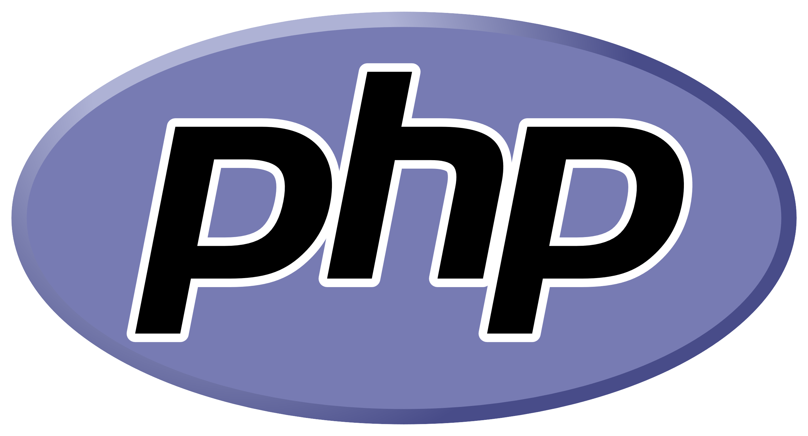
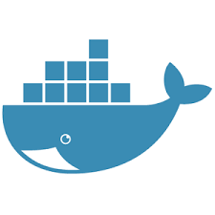

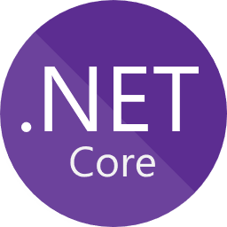


Any Cloud, Any Language, Any Platform
Azure DevOps supports all common languages, platforms and on-premise and other clouds!
Windows, Linux, Docker, Kubernetes, …
Java, .NET, Node.JS, Go, Python, PHP, …
Microsoft hosted (Azure DevOps Services) or host it yourself (Azure DevOps Server*)
*TFS will become Azure DevOps Server when Azure DevOps Server 2019 is released

Slide 15
DevOps your way
Azure Boards
Azure Repos
Azure Artifacts
(Other Azure)
Azure Pipelines
Azure Test Plans
(Other Azure)
Agile management
Development workflow
Artifact management
Automated build / deploy and release pipelines
Infrastructure, Policy & Configuration as Code
Operations, Learning & Feedback
Test & Verification
Sticky notes Excel Jira Trello Etc. | (Add logos?) GitHub Enterprise GitHub Subversion BitBucket Etc. | Azure Container Registry Artifactory MyGet Nexus NuGet Maven NPM Etc. | ARM Templates PowerShell DSC Terraform Chef Ansible Puppet Salt Etc. | Jenkins CircleCI Octopus Deploy Travis Etc. | Azure Cloud Load Test MSTest Micro Focus ALM (HP ALM) Selenium JUnit xUnit NUnit Etc. | (Ad Azure resources Application Insights Azure monitoring VMWare AWS GCP Splunk New Relic Etc.
Notes:
You can use all of the Microsoft DevOps tools together as an integrated suite or … [click]
you can pick-and-choose the tools that are right for your environment. For example, maybe you’re using our
core developer and artifact capabilities and our Application Performance Monitoring but deploying and configuring VMs
on-premise using a collection of different tools. Or… [click]
Perhaps you’re only adopting a subset of DevOps practices using tools such as GitHub and Terraform tied to Azure Pipelines
with Azure’s operations tooling.

Slide 16

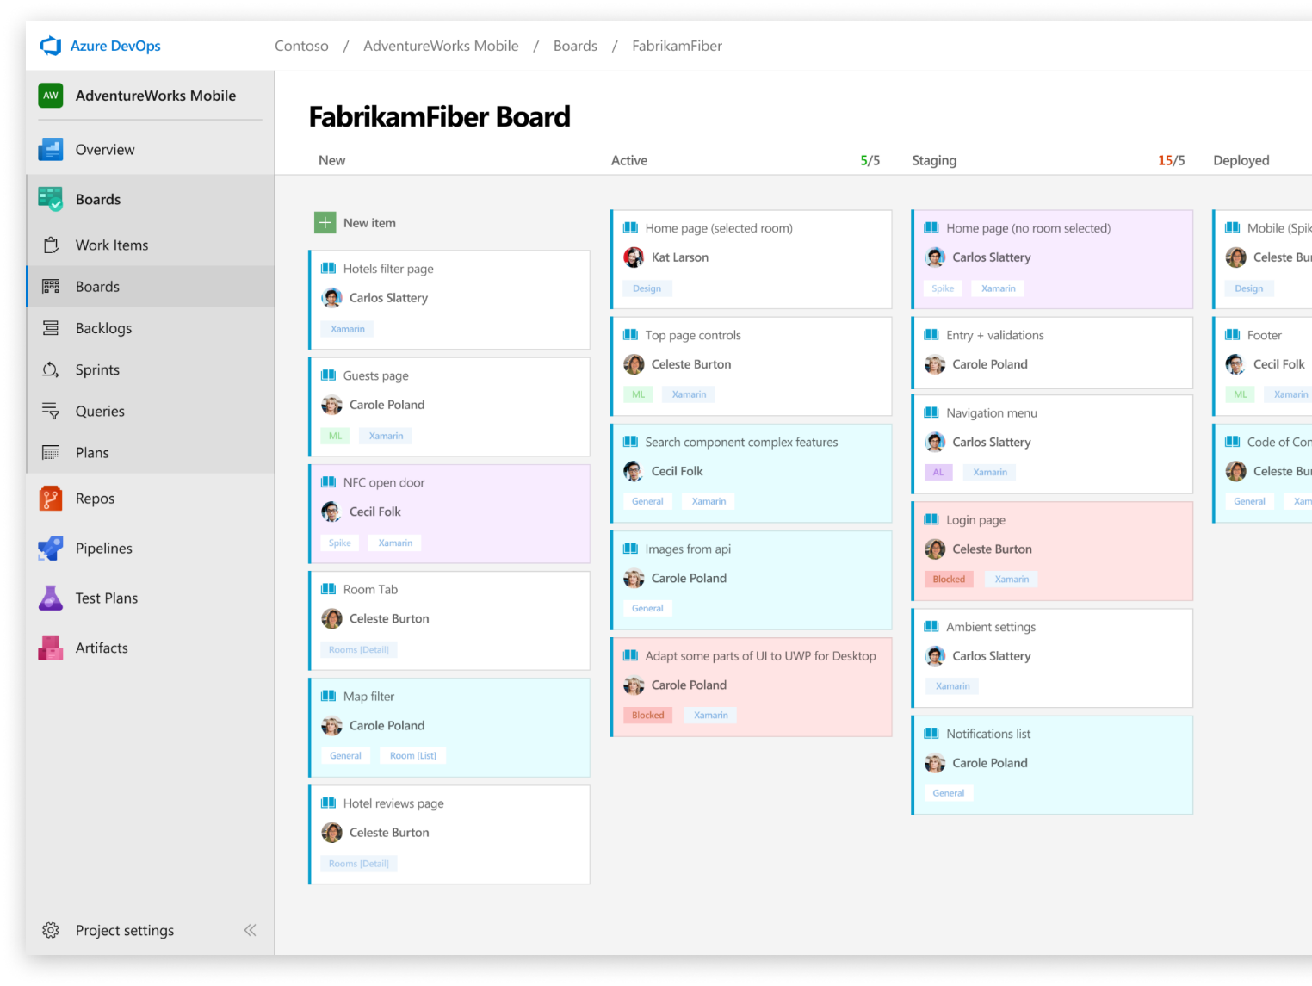



Azure Boards
Flexible work tracking with Kanban boards, backlogs, team dashboards, and custom reporting
Connected from idea to release
All your code changes are linked directly to your work items, so you can track all your ideas at every stage in the development process to keep your team aligned.
Scrum ready
Use built-in scrum boards and planning tools to help your teams run sprints, stand-ups, and planning meetings.
Project insights
Use our analytics tools and dashboard widgets to bring you and your team new insights into the health and status of your project.
➔
https://azure.com/devops
Notes:
Combine Kanban boards and drag-and-drop sprint planning with comprehensive traceability and reporting for the perfect home for all your ideas–big and small.

Slide 17
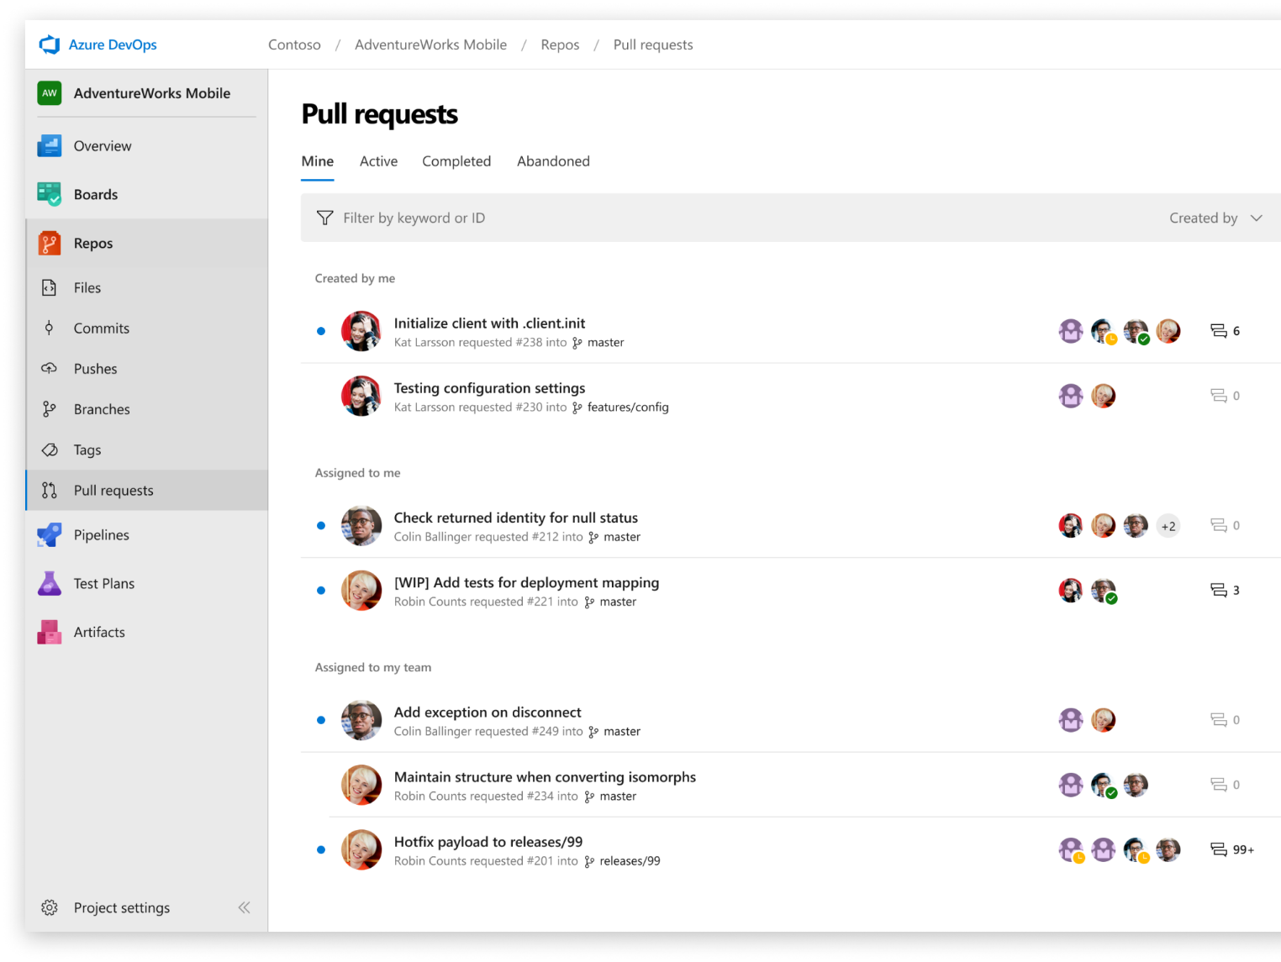



Azure Repos
Unlimited private Git repo hosting and support for TFVC that scales from a hobby project to the world’s largest Git repositories
Works with your Git client
Securely connect with, and push code into, unlimited free private Git repos from any IDE, editor or Git client
Web hooks and API integration
Add validations and extensions from the marketplace or build your own using web hooks and REST APIs.
Semantic code search
Quickly get to what you’re looking for with code-aware search that understands classes and variables.
➔
https://azure.com/devops
Notes:
Collaborate on code changes with threaded discussion and continuous integration for each change. Use forks to promote collaboration with Inner Source workflows.

Slide 18
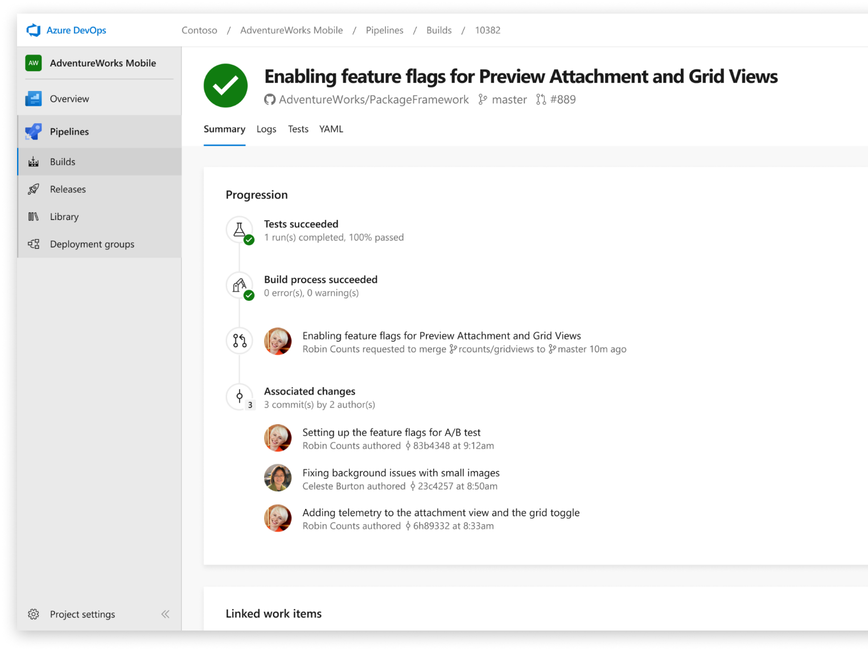


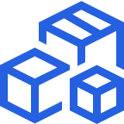

Azure Pipelines
Cloud-hosted pipelines for Linux, Windows and macOS, with unlimited minutes for open source
Any language, any platform, any cloud
Build, test, and deploy Node.js, Python, Java, PHP, Ruby, C/C++, .NET, Android, and iOS apps. Run in parallel on Linux, macOS, and Windows. Deploy to Azure, AWS, GCP or on-premises
Extensible
Use a range of build, test, and deployment tasks – hundreds of extensions from Slack to SonarCloud. Support for YAML, reporting and more
Containers and Kubernetes
Build and push images to container registries like Docker Hub and Azure Container Registry. Deploy containers to individual hosts or Kubernetes.
Best-in-class for open source
Fast CI/CD for every open source project. Azure Pipelines gives 10 free concurrent jobs with unlimited build minutes to all open source projects.
➔
https://azure.com/pipelines
Notes:
Azure Pipelines is the perfect launchpad for your code – automating your builds and deployments so you spend less time with the nuts and bolts and more time being creative

Slide 19
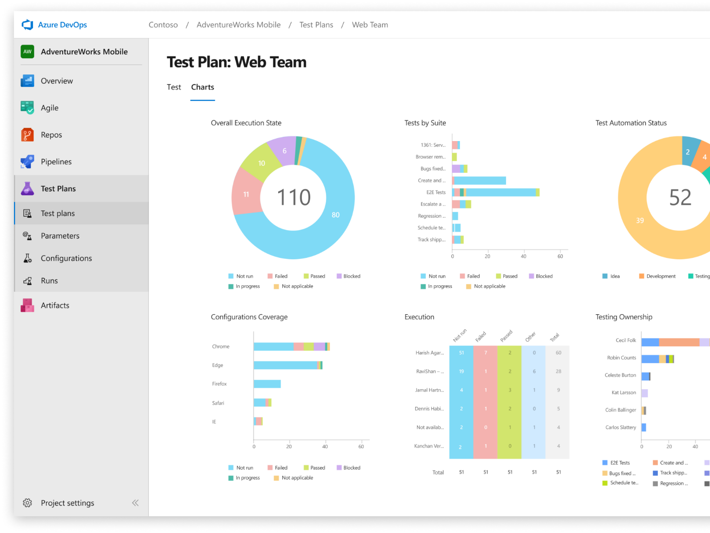
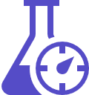


Azure Test Plans
Get end-to-end traceability. Run tests and log defects from your browser. Track and assess quality throughout your testing lifecycle.
Capture rich data
Make your defects actionable by capturing rich scenario data as you execute tests. Explore user stories without test cases or test steps. You can create test cases directly from your exploratory test sessions.
Hybrid testing
Test your application where it lives. Complete scripted tests across desktop or web scenarios. Test on-premises application from the cloud and vice-versa
On demand user acceptance testing
Leverage the same test tools across your engineers and user acceptance testing stakeholders. Pay for the tools only when you need them.
➔
https://azure.com/devops
Notes:
Collaborate on code changes with threaded discussion and continuous integration for each change. Use forks to promote collaboration with Inner Source workflows.

Slide 20
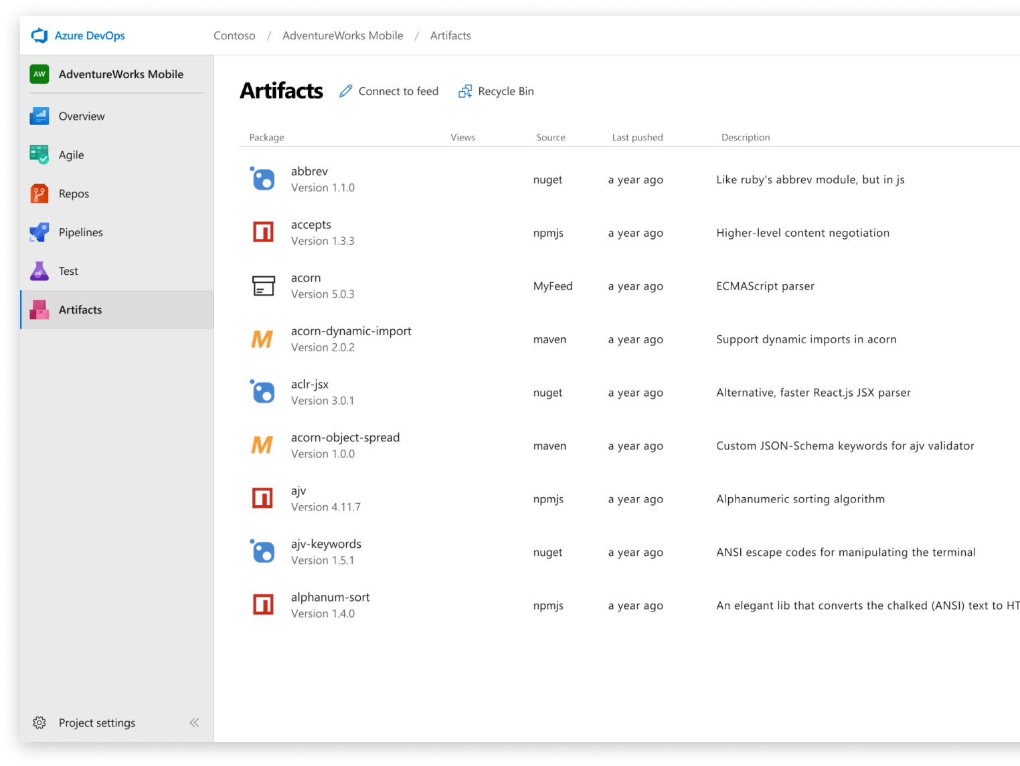



Azure Artifacts
Share Maven, npm, and NuGet packages from public and private sources with your team –fully integrated into CI/CD pipelines
For all package types
Universal artifact management for Maven, npm, and NuGet
For any DevOps pipeline
Built-in CI/CD, versioning, and testing for your packages
For teams of any size
Leverage the same test tools across your engineers and user acceptance testing stakeholders. Pay for the tools only when you need them.
➔
https://azure.com/devops
Notes:
Collaborate on code changes with threaded discussion and continuous integration for each change. Use forks to promote collaboration with Inner Source workflows.

Slide 21
Introducing Azure DevOps
Azure Boards
Azure Repos
Azure Pipelines
Azure Test Plans
Azure Artifacts
Plan, track, and discuss work across teams, deliver value to your users faster.
Unlimited cloud-hosted private Git repos. Collaborative pull requests, advanced file management, and more.
CI/CD that works with any language, platform, and cloud. Connect to GitHub or any Git provider and deploy continuously to any cloud.
The test management and exploratory testing toolkit that lets you ship with confidence.
Create, host, and share packages. Easily add artifacts to CI/CD pipelines.

Slide 22
Better together
An end-to-end solution for organizations looking for enterprise-grade DevOps tools
Azure DevOps
Azure Boards
Azure Repos
Azure Pipelines
Azure Test Plans
Azure Artifacts
And better with Azure!
Built on Azure
Bills through Azure
Secured with Azure
Uses AAD
Used to build Azure itself
Fastest way to deploy to Azure!
Fully Integrated with end to end traceability
Scalable to any team or project size
Highly available, multi region
Customer Support
Consistent administration and access control

Slide 23
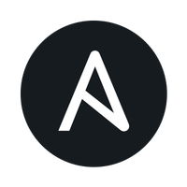




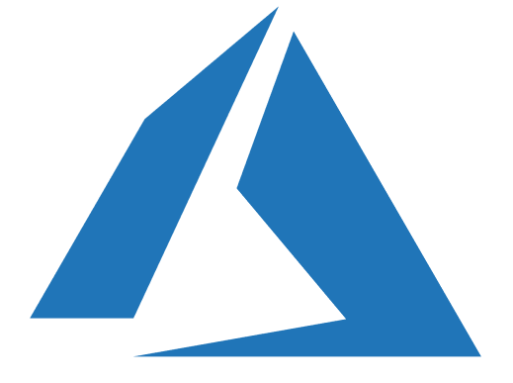

Choose the tools and clouds you love
Azure DevOps lets developers choose the tools that are right for them
Mix and match to create workflows with Microsoft 1st party or 3rd party tools
Target the clouds and systems you need
Azure Boards
GitHub
Azure Pipelines
Jfrog Artifactory
Ansible
Trello
Azure Repos
Azure Test Plans
Jenkins
Azure Artifacts
Azure
Amazon
Google
Linux
Windows
MacOs
Docker
Kubernetes

Slide 24


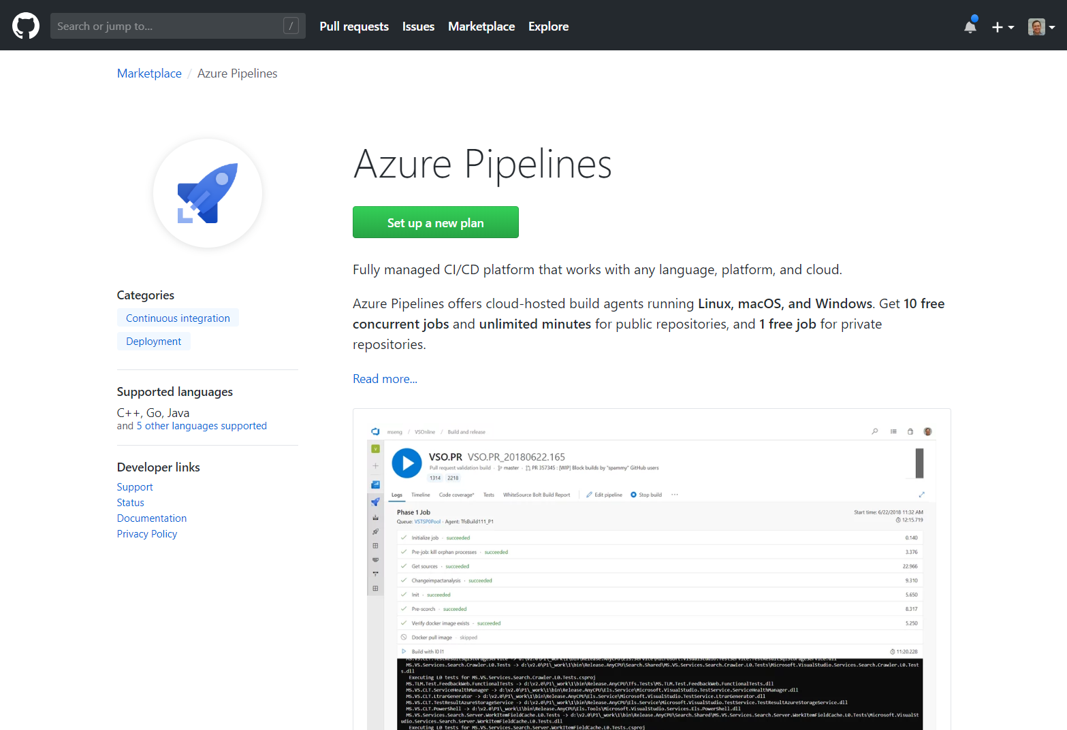
Microsoft Open Source
Acquire directly through
the GitHub marketplace
Azure Pipelines
10 Free
concurrent pipelines with unlimited build minutes for public projects
using mac, Linux and Windows.

Slide 25

Thank you! Your Feedback is Important
Rate My Talk & Download Slides!
http://bit.ly/RateShawnsTalk
(case sensitive)
Contact Information
Email: sweisfel@microsoft.com
Blog: http://www.shawnweisfeld.com
Twitter: @shawnweisfeld

